Slide 1


Slide 2
Network Traffic Analysis

Slide 3
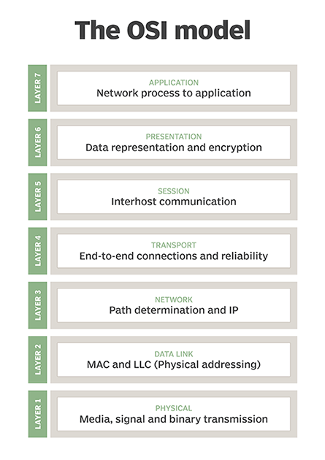
Layer 7: DATA
HTTP(S), DHCP, DNS, TSL/SSL, FTP, TELNET
Layer 4: SEGMENTS
TCP, UDP, port numbers
Layer 3: PACKETS
IP(v4/v6), ICMP
Layer 2: FRAMES
MAC, ARP, Ethernet
Layer 1: BITS
Copper cables, fiber optics, hubs

Slide 4
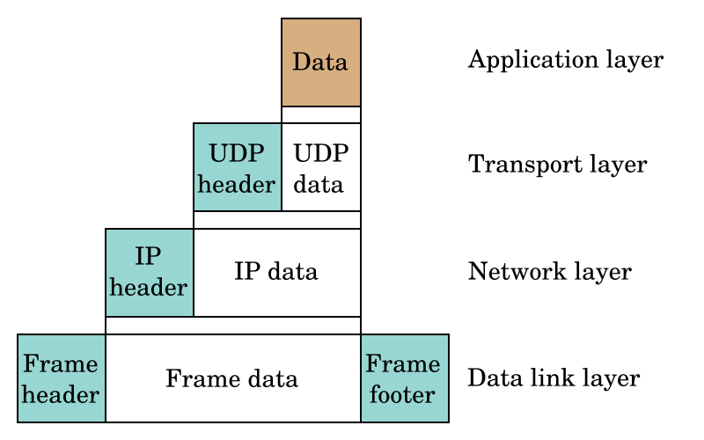

Slide 5
Addressing Schemes
Transport Layer: PORTS
Network Layer: IP ADDRESSES
Data Link Layer: MAC ADDRESSES

Slide 6
Quick Explanation of Other Protocols
File Transfer Protocol (FTP)
Telnet
uses TCP port 23
bidirectional interactive communication (CLI)
Internet Control Message Protocol (ICMP)
layer 3, no port number
includes ping, traceroute
used for diagnostic / error control purposes

Slide 7
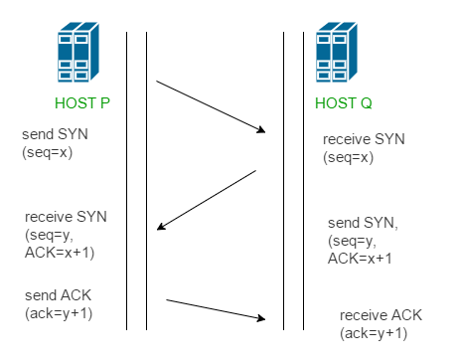
TCP 3-WAY HANDSHAKE
establishes synchronized connections between a client & server

Slide 8
Address Resolution Protocol (ARP)
computers can communicate via IP addresses
but in order for them to communicate at Layer3, they need to be able to communicate at both Layer2 and Layer1
layer 2 communication → MAC addresses
question: if I know the IP address of a server that I want to talk to, but I don’t know the MAC address, how can I find the MAC address of the server?
answer: ARP

Slide 9
Types of HTTP Authentication
Basic Auth
Cookies
helps prevent XSRF (Cross-Site Request Forgery)
Tokens
JSON Web Tokens
helps prevent XSS (Cross-Site Scripting)
Signatures
One-Time Passwords
Time-based
HMAC-based

Slide 10
HTTP Basic Authentication
Basic Auth
username and password
doesn’t require cookies, etc.
client sends an Authorization HTTP header
structure
username:password
base64 encoded
curl --header “Authorization: Basic user:pass” https://website.com

Slide 11
Internet Control Message Protocol (ICMP)
Layer3 protocol
DOES NOT exist on a TCP/UDP port
commonly used ICMP is ping
echo request / echo reply
just sends empty bytes
Time to Live (TTL): how long the packet is going to attempt to find the other computer before it’s dropped

Slide 12
FTP Methods
Like with what we’ve seen for HTTP, FTP has its own methods that define behavior/action
https://en.wikipedia.org/wiki/List_of_FTP_commands

